Slide 1
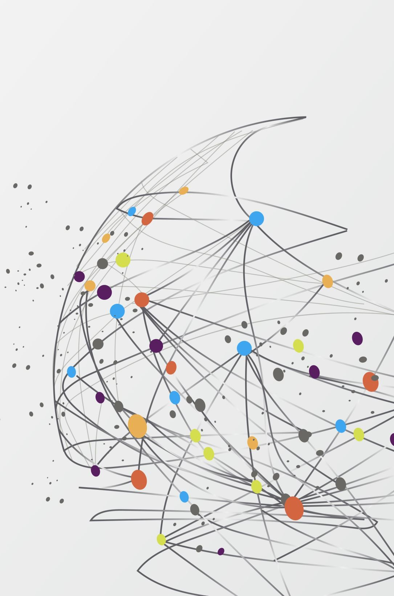

DataViz AI
Transforming Queries into Insightful Visuals Instantly!" 🚀📊

Slide 2
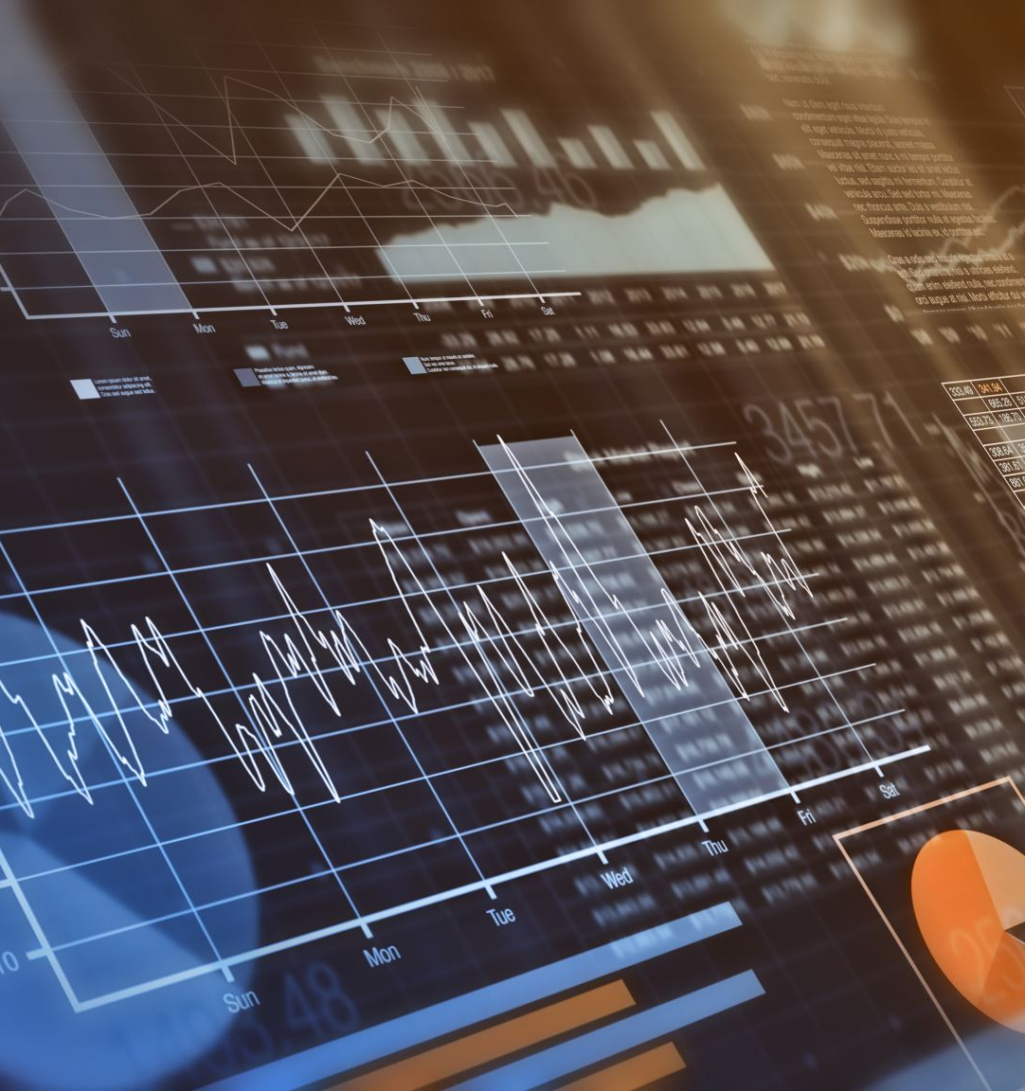
What is DataViz AI?
🚀 AI-powered Data Visualization: Converts natural language queries into meaningful charts and insights.
📊 Interactive & Intuitive: Generates dynamic visualizations for easy data interpretation.
🔍 Smart Query Processing: Understands and executes database queries with AI assistance.
⚡ Fast & Efficient: Provides real-time analytics and instant visual feedback.
🛠️ Seamless Integration: Works with various data sources for enhanced decision-making.

Slide 3

Why Did We Build This? (Challenges in Data Visualization)
❌ Complexity in Data Interpretation: Many users struggle to convert raw data into meaningful insights.
⏳ Time-Consuming Manual Efforts: Traditional tools require extensive manual work to create visual reports.
🤖 Lack of AI-Driven Automation: Existing solutions often lack intelligent automation for chart generation.
📊 Non-Technical Users Struggle: Requires programming or SQL knowledge to generate visualizations.
🔄 Inefficient Data Querying: Extracting insights from databases is often slow and tedious.
🚀 Need for Real-Time Insights: Businesses require instant data-driven decisions with minimal effort.

Slide 4
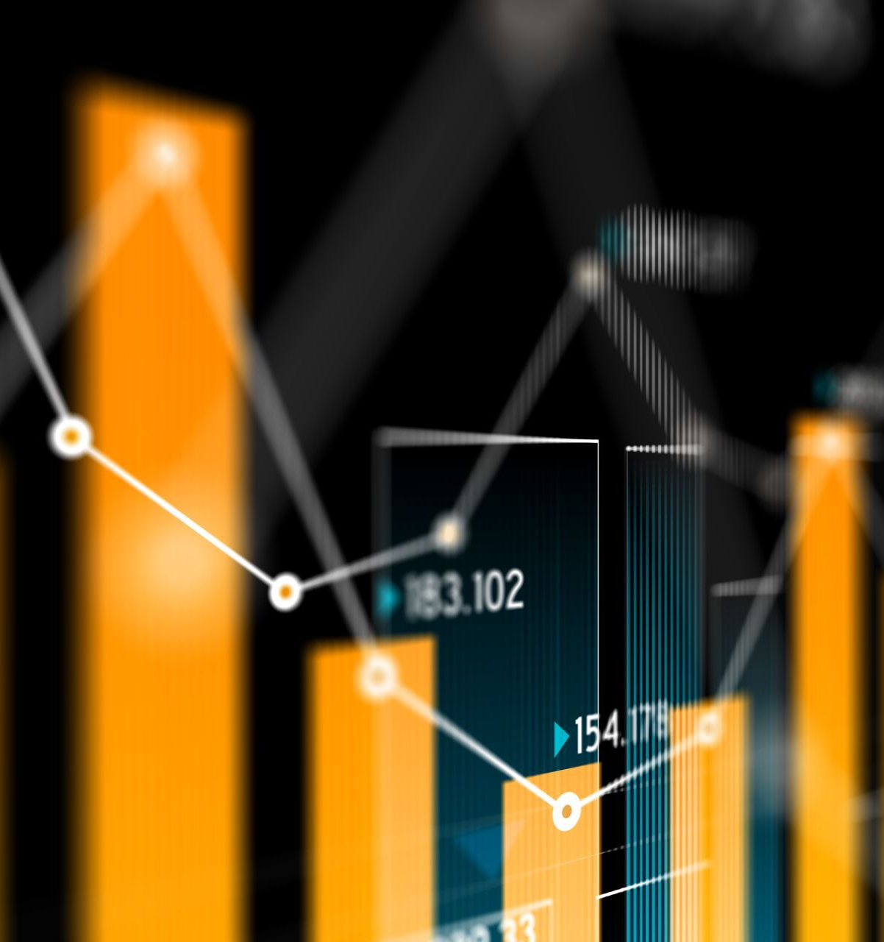
How DataViz AI solves the problem
🚀 AI-Powered Chart Generation – Instantly transforms text-based queries into meaningful visualizations.
🤖 Automated Data Querying – No need for complex SQL; AI interprets natural language and fetches insights.
🎨 User-Friendly Interface – Simple and intuitive UI, making data visualization accessible to everyone.
⚡ Real-Time Insights – Generates charts and reports within seconds, eliminating manual effort.
🔍 Enhanced Decision-Making – Provides clear and accurate data representations for better business insights.
🔗 Seamless Integration – Easily connects with databases and APIs for smooth data retrieval.

Slide 5
Tech Stack – The technologies used (React, Node.js, Python, Flask, etc.)
⚛ Frontend: React.js – For a smooth and interactive user experience.
🐍 Backend: Python, Flask – Handles API requests and processes AI-powered queries.
📊 Data Visualization: Matplotlib, Seaborn, Plotly – Creates dynamic charts and graphs.
🗄 Database: PostgreSQL / MySQL – Efficiently stores and retrieves structured data.
🔄 API Integration: Axios – Facilitates seamless communication between frontend and backend.

Slide 6
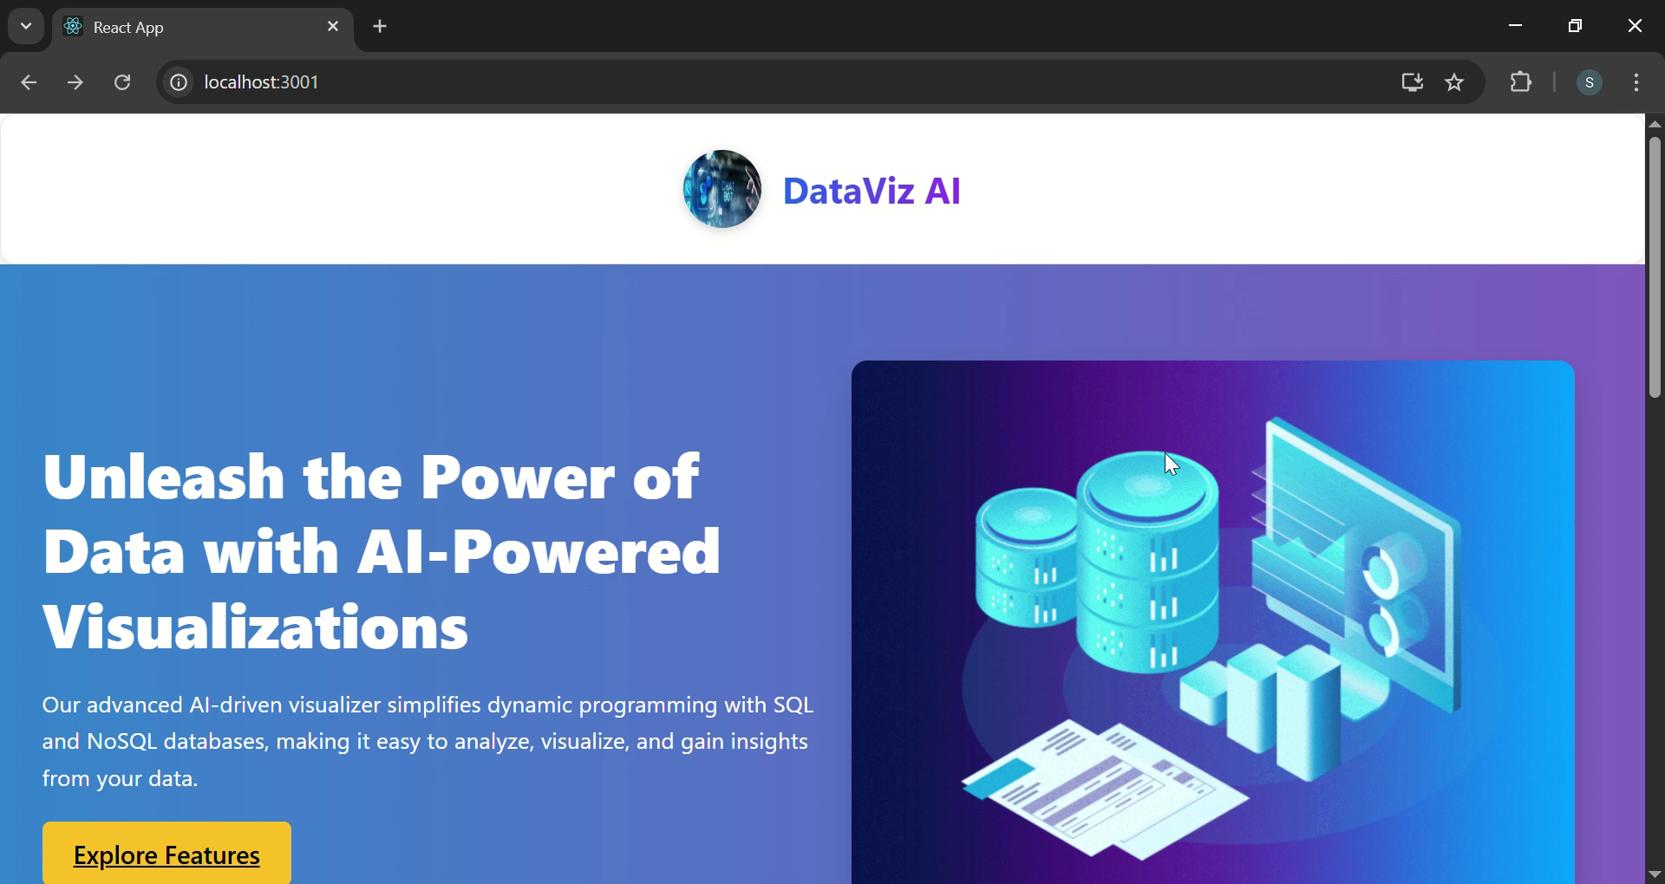
🖥 Demo & Screenshots – See DataViz AI in Action
Here’s a glimpse of how DataViz AI simplifies data visualization and analysis.
From inputting a query to generating insightful charts—everything in just a few clicks!

Slide 7
Challenges & Learning
Challenges Faced:
AI Integration Complexity 🤖 – It was challenging to seamlessly integrate AI for handling different types of queries and chart generation.
Dynamic Prompt Engineering 📝 – Designing the right prompts for AI to generate accurate SQL queries and meaningful visualizations required multiple iterations.
Performance Optimization 🚀 – Ensuring quick query execution and chart rendering without latency issues was a key challenge.
Error Handling & Validation ❌ – Handling incorrect queries and providing meaningful error messages required robust logic.

Slide 8
🚀 Bridging the Gap: DataViz AI vs. Power BI & Tableau
Feature | Power BI | Tableau | DataViz AI
Ease of Use | Medium | Medium | ✅ AI-driven, user-friendly
NoSQL Support | ❌ No | ❌ No | ✅ Yes
AI-Powered Insights | ❌ Limited | ❌ Limited | ✅ Fully AI-driven
Automation & Query Execution | ❌ Manual | ❌ Manual | ✅ Automatic
Customization | ✅ High | ✅ High | ✅ Fully flexible
Cost | 💲 Expensive | 💲 Expensive
Affordable

Slide 9
Current Challenges in Data Visualization with Power BI & Tableau
High Cost 💰 – Expensive licensing and infrastructure costs.
Complexity in Usage 🛠️ – Requires technical expertise; steep learning curve.
Limited NoSQL & Unstructured Data Support 📊 – Not ideal for real-time NoSQL data sources.
Manual Effort for AI-Powered Insights 🤖 – AI-driven analytics & automation are limited.
Real-time Processing is Limited ⏳ – Hard to generate instant, dynamic visualizations.

Slide 10
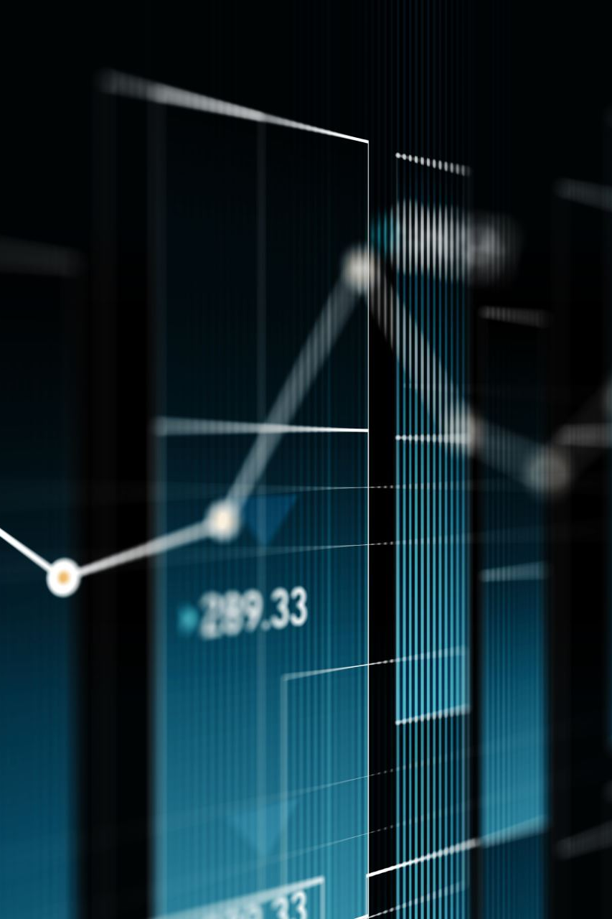
How DataViz AI Bridges the Gap
Cost-Effective Solution 💲 – No expensive licensing; built for scalability.
User-Friendly Interface 🎯 – AI automates chart generation, reducing manual effort.
Full NoSQL & Unstructured Data Support 🗃️ – Works seamlessly with MongoDB, Firebase, Elasticsearch, etc.
AI-Powered Insights & Natural Language Queries 🤖 – Ask questions, and DataViz AI generates smart visualizations.
Real-time, Interactive Analytics ⏱️ – Instantly processes and visualizes data from multiple sources.

Slide 11
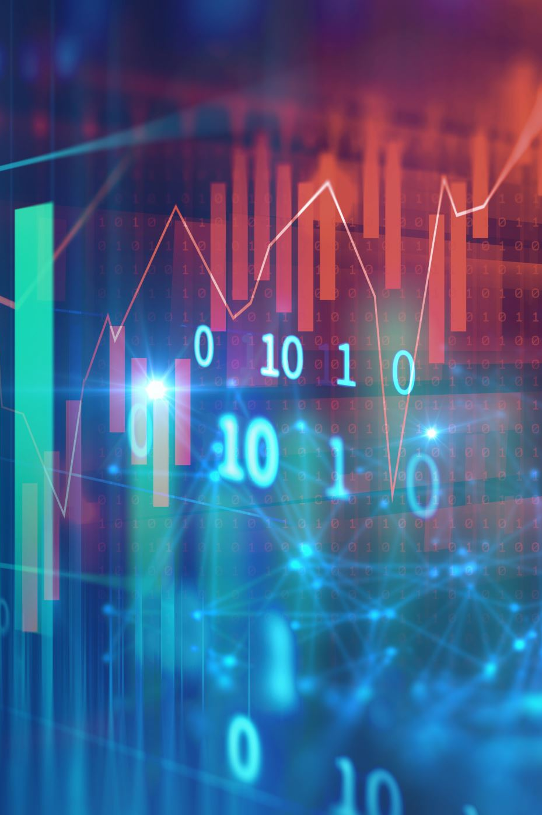
The Growing Need for AI-Powered Data Visualization in Key Industries
🛒 E-commerce (Amazon, Flipkart, etc.)
🔹 Challenge: Large-scale unstructured data from sales, customers, and inventory. 🔹 Need: Real-time AI-driven analytics for demand forecasting & customer insights.
🏦 Financial Institutions (Banks, Investment Firms)
🔹 Challenge: Massive data for fraud detection, risk assessment, and trading analysis. 🔹 Need: Faster AI-powered pattern recognition & anomaly detection.
🏥 Healthcare (Hospitals, Research Centers)
🔹 Challenge: Complex patient records & medical research data. 🔹 Need: AI-assisted visualization for trend analysis and predictive healthcare.
📡 Telecommunication (Verizon, AT&T, etc.)
🔹 Challenge: Huge datasets on network performance & user behavior. 🔹 Need: AI-powered dashboards for real-time network optimization.
📢 Marketing & Advertising Agencies
🔹 Challenge: Multi-channel campaign analytics and consumer data overload. 🔹 Need: AI-generated reports & insights to improve marketing strategies.

Slide 12
How DataViz AI Empowers Industries
AI-powered data insights for smarter decision-making
NoSQL integration to efficiently handle unstructured data
Real-time analytics for instant trend visualization
Predictive analysis for better strategic planning
Enhanced data accessibility for all users, not just data experts
Customizable dashboards tailored to different business needs
Seamless data integration from multiple sources
User-friendly interface with an intuitive design for easy adoption

Slide 13

Thanking you

